Slide 1
Natural Language Processing Specialization Neural Machine Translation with Attention
(2021 Deeplearning.ai)
YangXi’s Reading Notes

Slide 2
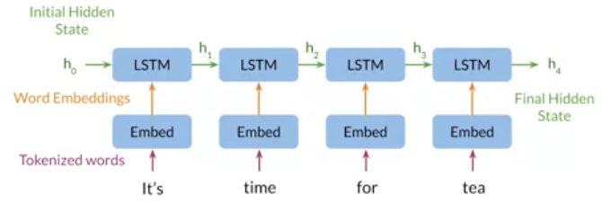
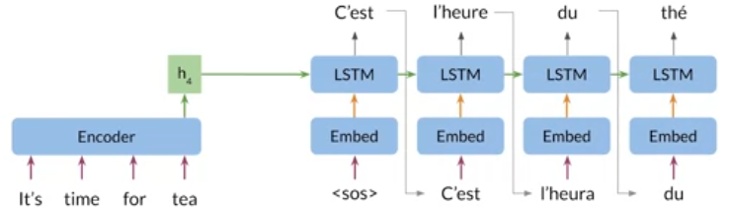
Neural Machine Translation (NMT) – Seq2Seq
Neural machine translation uses an encoder and a decoder to translate
Seq2Seq (Google 2014): maps variable-length sequences to fixed-length memory
Advantage: Input and output sequences can have different lengths
The information bottleneck: fixed-length hidden state cannot effectively handle long sequences
Seq2Seq performs well for sequences of 10 - 20 words, but the performance drops for longer sequences
One “walk-around”: instead of output one final hidden state from the encoder, let’s use one hidden state for each word, and pass all the hidden states to the decoder. This will take too much memory.
Attention makes it possible for the model to select and focus on the most important words (hidden states) at each time step
The decoder can access all relevant parts of the input sequence regardless of its length
Seq2Seq Encoder
Seq2Seq Decoder

Slide 3
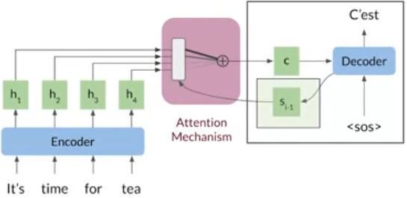
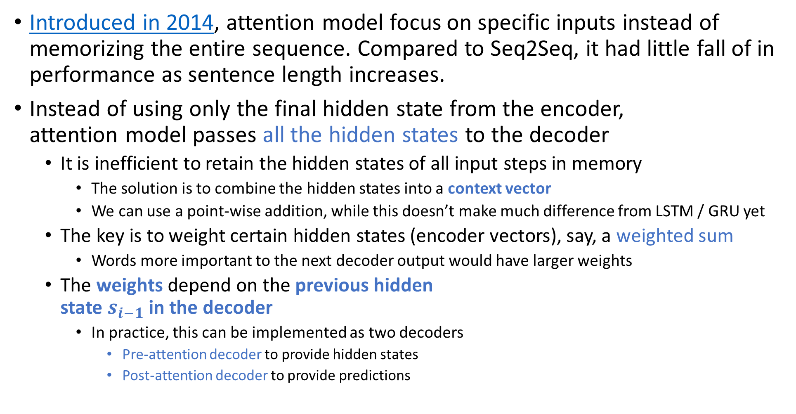
Attention – the Motivation
Introduced in 2014, attention model focus on specific inputs instead of memorizing the entire sequence. Compared to Seq2Seq, it had little fall of in performance as sentence length increases.
Instead of using only the final hidden state from the encoder, attention model passes all the hidden states to the decoder
It is inefficient to retain the hidden states of all input steps in memory
The solution is to combine the hidden states into a context vector
We can use a point-wise addition, while this doesn’t make much difference from LSTM / GRU yet
The key is to weight certain hidden states (encoder vectors), say, a weighted sum
Words more important to the next decoder output would have larger weights
The weights depend on the previous hidden state $s_{i−1}$ in the decoder
In practice, this can be implemented as two decoders
Pre-attention decoder to provide hidden states
Post-attention decoder to provide predictions

Slide 4
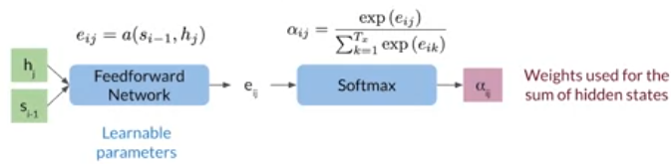
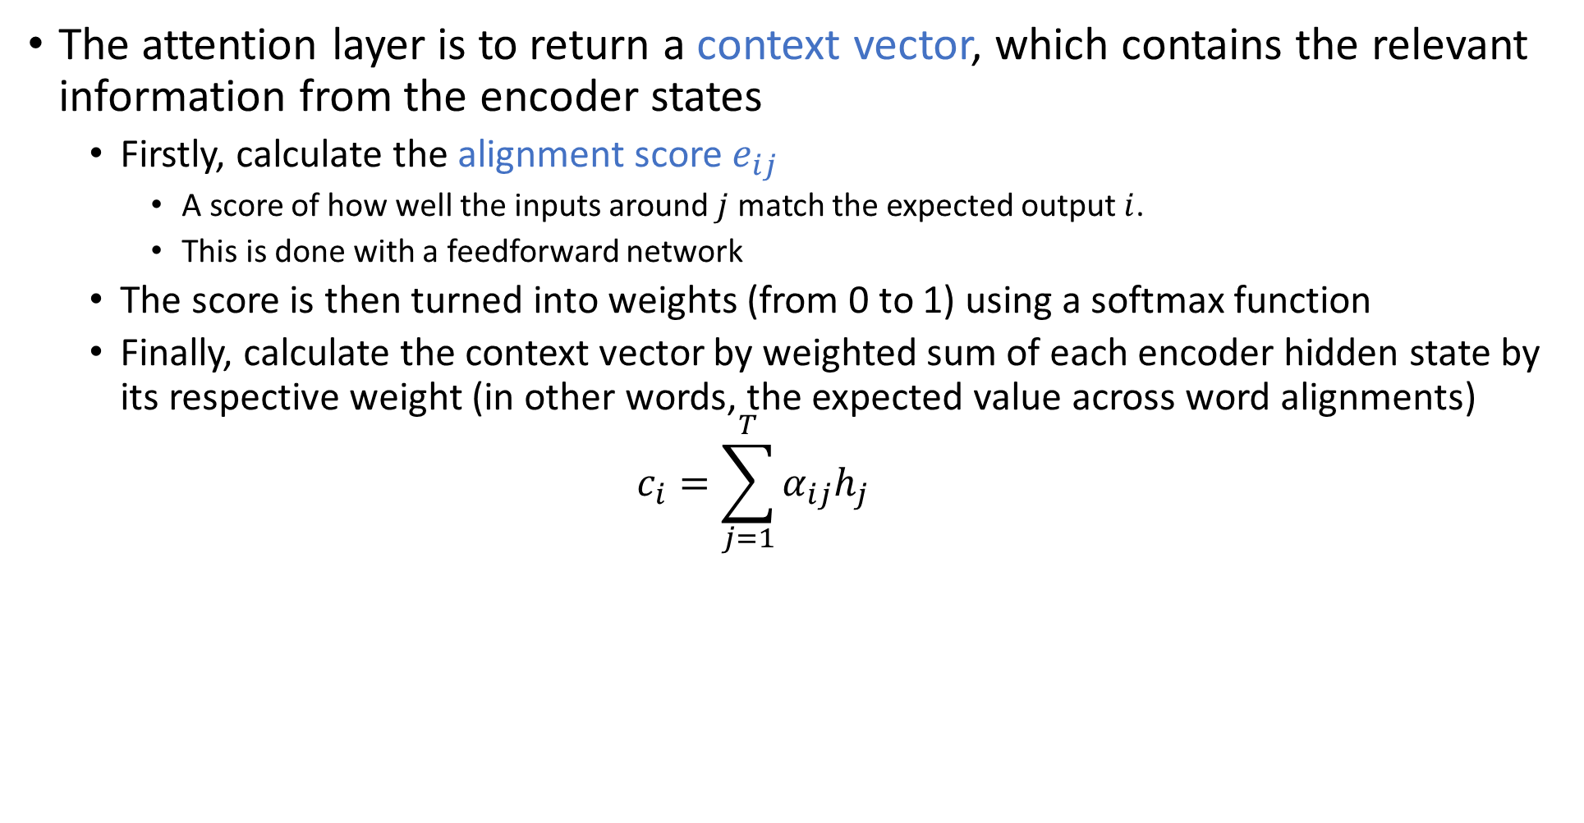
The Attention Layer
The attention layer is to return a context vector, which contains the relevant information from the encoder states
Firstly, calculate the alignment score $e_{ij}$
A score of how well the inputs around $j$ match the expected output $i$.
This is done with a feedforward network
The score is then turned into weights (from 0 to 1) using a softmax function
Finally, calculate the context vector by weighted sum of each encoder hidden state by its respective weight (in other words, the expected value across word alignments) $c_{i}=\sum_{j=1}^{T}{α_{ij}h_{j}}$

Slide 5
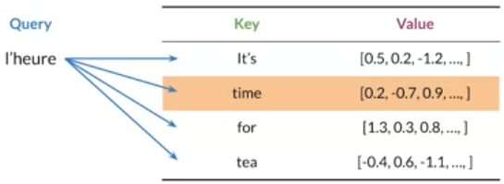
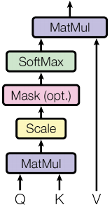
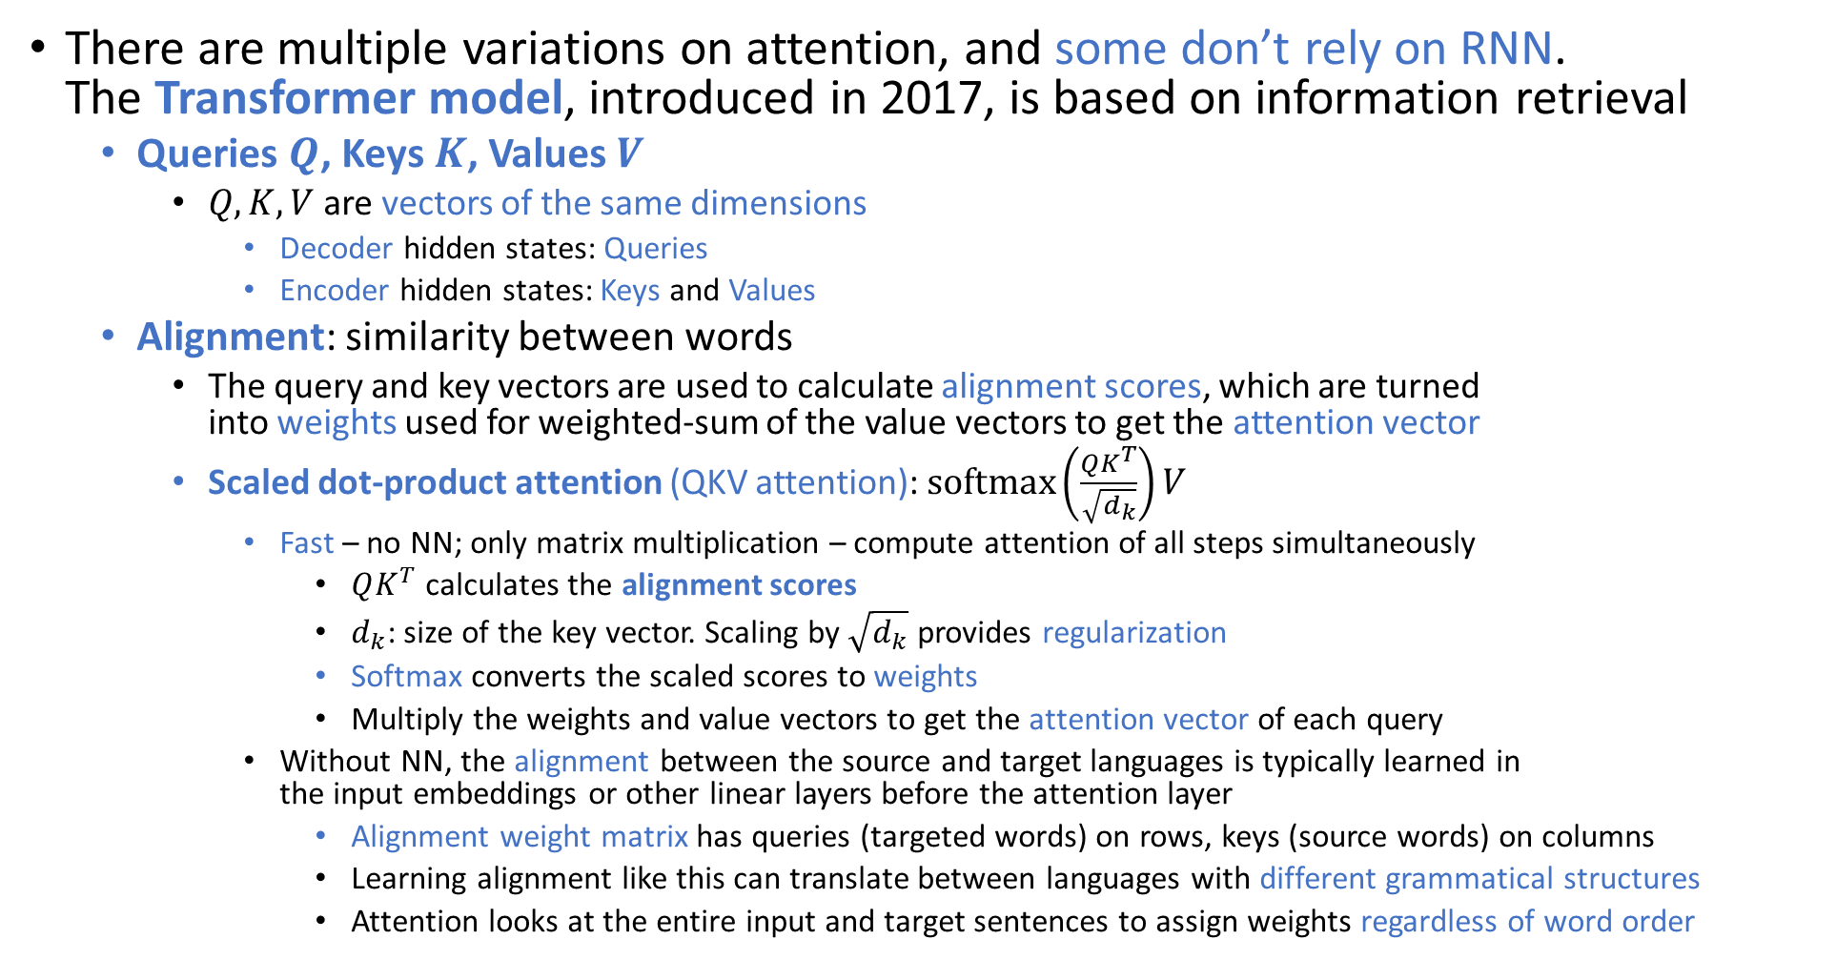
Transformer – Queries, Keys, Values, Alignment
There are multiple variations on attention, and some don’t rely on RNN. The Transformer model, introduced in 2017, is based on information retrieval
Queries $Q$, Keys $K$, Values $V$
$Q, K, V$ are vectors of the same dimensions
Decoder hidden states: Queries
Encoder hidden states: Keys and Values
Alignment: similarity between words
The query and key vectors are used to calculate alignment scores, which are turned into weights used for weighted-sum of the value vectors to get the attention vector
Scaled dot-product attention (QKV attention): $softmax\left(\frac{QK^{T}}{\sqrt{d_{k}}}\right)V$
Fast – no NN; only matrix multiplication – compute attention of all steps simultaneously
$QK^{T}$ calculates the alignment scores
$d_{k}$: size of the key vector. Scaling by $\sqrt{d_{k}}$ provides regularization
Softmax converts the scaled scores to weights
Multiply the weights and value vectors to get the attention vector of each query
Without NN, the alignment between the source and target languages is typically learned in the input embeddings or other linear layers before the attention layer
Alignment weight matrix has queries (targeted words) on rows, keys (source words) on columns
Learning alignment like this can translate between languages with different grammatical structures
Attention looks at the entire input and target sentences to assign weights regardless of word order

Slide 6
Train a Neural Machine Translation (NMT) Model
Training Setup
The state-of-the-art models used pre-trained vector embeddings
Otherwise, initially represent words with one-hot vectors
Keep track of index mappings with word2ind and ind2word dictionaries
Add end of sequence tokens <EOS>
Pad the token vectors with zeros to match the length of the longest sequence
In training, decoder outputs are compared to the target sequence to calculate loss
You calculate the cross-entropy loss for each step, then sum up to get the total loss
In practice, this doesn’t work well
At the early stage, the model is naïve, and it makes wrong predictions early in the sequence
Recalled that in Seq2Seq, decoder output of a step is used as the input to the next step
Errors in the early steps will compound, and the later steps will get even further from the target
Teacher Forcing: use the target words as the decoder inputs, instead of the decoder outputs
Teacher forcing makes training much faster
There are some variations, for example, curriculum learning: you can slowly start using decoder outputs over time, so that late in the training, you no longer feed in the target words.

Slide 7
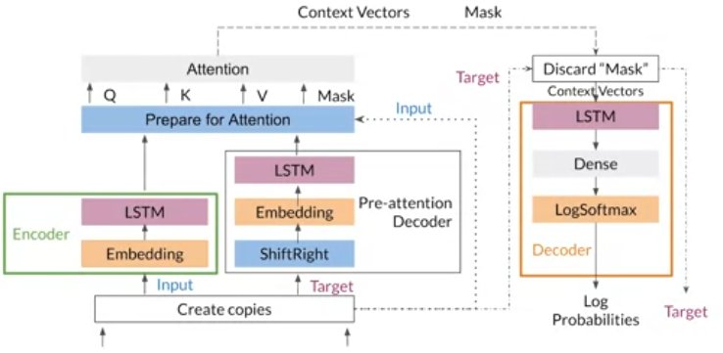
Put Everything Together – NMT Model with Attention
Padding mask to help the attention layer determine the padding tokens. You need the copy of the input tokens for this.
Hidden states as Queries
Hidden states as Keys and Values
Make copies of the input and target sequences, because you will use them in different places of the model
Shift target sequence rightwards for Teacher Forcing

Slide 8

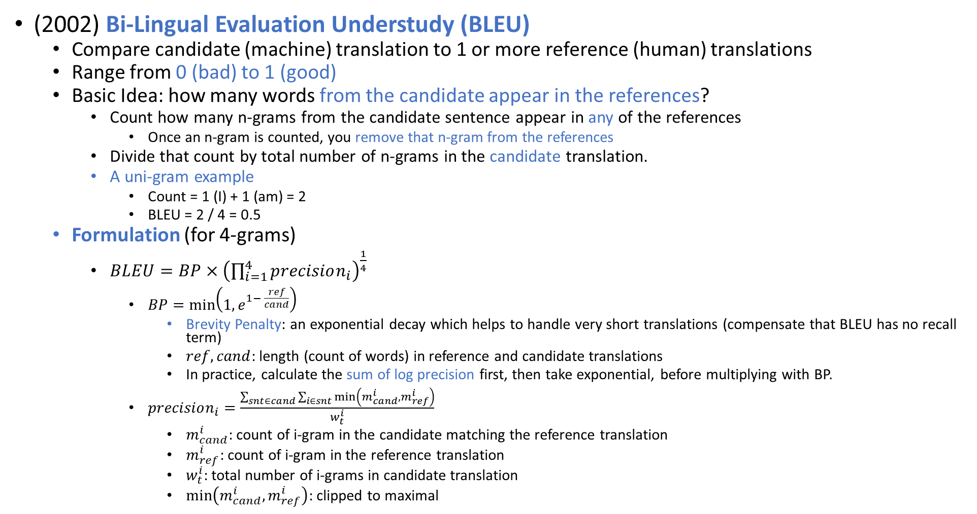
Evaluating Machine Translation Models - BLEU Score
(2002) Bi-Lingual Evaluation Understudy (BLEU)
Compare candidate (machine) translation to 1 or more reference (human) translations
Range from 0 (bad) to 1 (good)
Basic Idea: how many words from the candidate appear in the references?
Count how many n-grams from the candidate sentence appear in any of the references
Once an n-gram is counted, you remove that n-gram from the references
Divide that count by total number of n-grams in the candidate translation.
A uni-gram example
Count = 1 (I) + 1 (am) = 2
BLEU = 2 / 4 = 0.5
Formulation (for 4-grams)
$BLEU=BP×{\left(\prod_{i=1}^{4}{precision_{i}}\right)}^{\frac{1}{4}}$
$BP=\min\left(1, e^{1− \frac{ref}{cand}}\right)$
Brevity Penalty: an exponential decay which helps to handle very short translations (compensate that BLEU has no recall term)
$ref,cand$: length (count of words) in reference and candidate translations
In practice, calculate the sum of log precision first, then take exponential, before multiplying with BP.
$precision_{i}=\frac{\sum_{snt∈cand}{\sum_{i∈snt}{\min\left(m_{cand}^{i}, m_{ref}^{i}\right)}}}{w_{t}^{i}}$
$m_{cand}^{i}$: count of i-gram in the candidate matching the reference translation
$m_{ref}^{i}$: count of i-gram in the reference translation
$w_{t}^{i}$: total number of i-grams in candidate translation
$\min\left(m_{cand}^{i}, m_{ref}^{i}\right)$: clipped to maximal

Slide 9
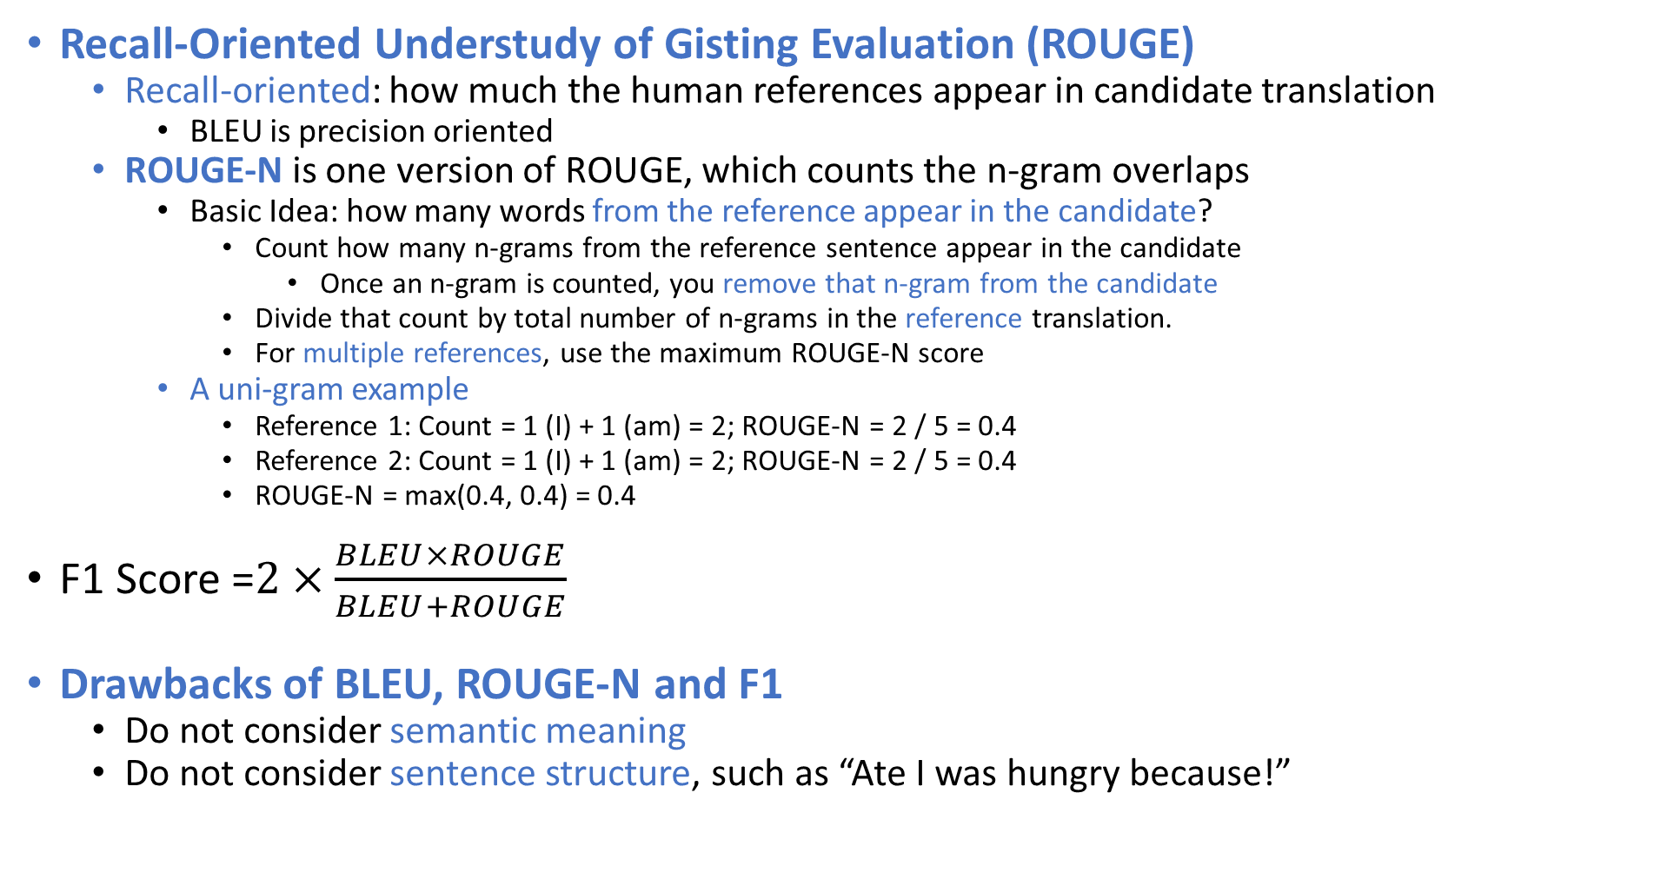
ROUGE-N Score and F1 Score
Recall-Oriented Understudy of Gisting Evaluation (ROUGE)
Recall-oriented: how much the human references appear in candidate translation
BLEU is precision oriented
ROUGE-N is one version of ROUGE, which counts the n-gram overlaps
Basic Idea: how many words from the reference appear in the candidate?
Count how many n-grams from the reference sentence appear in the candidate
Once an n-gram is counted, you remove that n-gram from the candidate
Divide that count by total number of n-grams in the reference translation.
For multiple references, use the maximum ROUGE-N score
A uni-gram example
Reference 1: Count = 1 (I) + 1 (am) = 2; ROUGE-N = 2 / 5 = 0.4
Reference 2: Count = 1 (I) + 1 (am) = 2; ROUGE-N = 2 / 5 = 0.4
ROUGE-N = max(0.4, 0.4) = 0.4
F1 Score =$2×\frac{BLEU×ROUGE}{BLEU+ROUGE}$
Drawbacks of BLEU, ROUGE-N and F1
Do not consider semantic meaning
Do not consider sentence structure, such as “Ate I was hungry because!”

Slide 10
Generate Candidate Translations
Recall that the decoder output at each step is a probability distribution over all words and symbols in the vocabulary
The final output of the model depends on choice of words at each step
Basic methods
Greedy Decoding
Select the most probable word at each step
Limitation: the best word at each step may not be the best for longer sequences
Random Sampling
Sample based on the probability distribution at each step
Limitation: too random
Solution: assign more weight to more probable words, and less weight to less probable words
Temperature: (0 to 1) control less to more randomness. 0 will give you Greedy Decoding.
More advanced methods
Beam Search
Minimum Bayer Risk

Slide 11
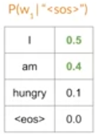
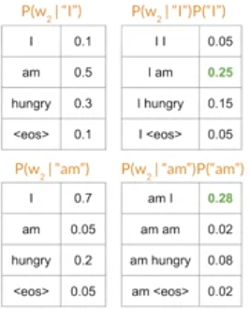
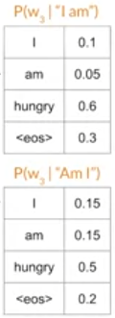
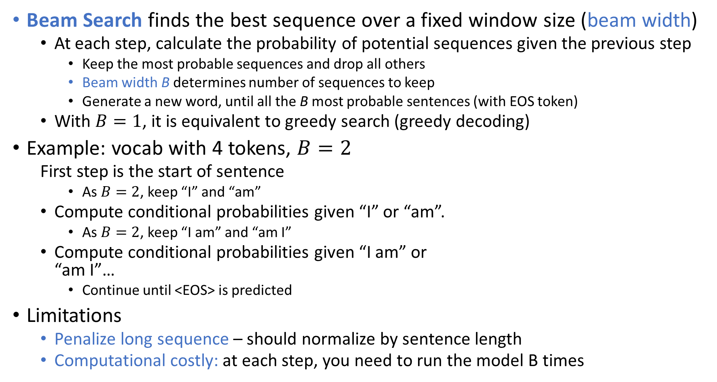
Beam Search
Beam Search finds the best sequence over a fixed window size (beam width)
At each step, calculate the probability of potential sequences given the previous step
Keep the most probable sequences and drop all others
Beam width B determines number of sequences to keep
Generate a new word, until all the B most probable sentences (with EOS token)
With $B=1$, it is equivalent to greedy search (greedy decoding)
Example: vocab with 4 tokens, $B=2$
First step is the start of sentence
As $B=2$, keep “I” and “am”
Compute conditional probabilities given “I” or “am”.
As $B=2$, keep “I am” and “am I”
Compute conditional probabilities given “I am” or “am I”…
Continue until <EOS> is predicted
Limitations
Penalize long sequence – should normalize by sentence length
Computational costly: at each step, you need to run the model B times

Slide 12
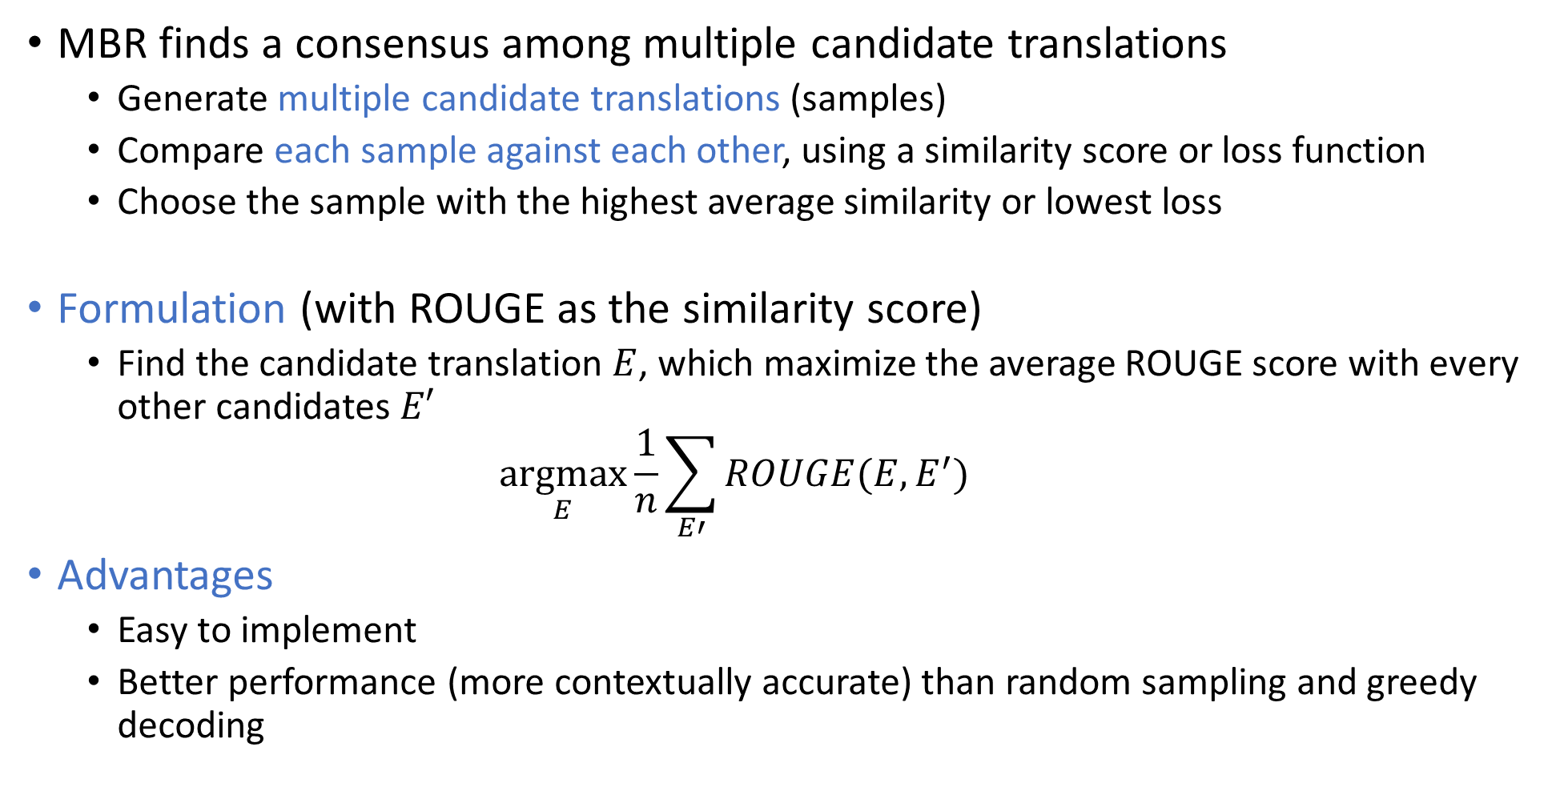
Minimum Bayer Risk (MBR)
MBR finds a consensus among multiple candidate translations
Generate multiple candidate translations (samples)
Compare each sample against each other, using a similarity score or loss function
Choose the sample with the highest average similarity or lowest loss
Formulation (with ROUGE as the similarity score)
Find the candidate translation $E$, which maximize the average ROUGE score with every other candidates $E′$ $\underset{E}{argmax}{\frac{1}{n}\sum_{E′}{ROUGE(E,E^{′})}}$
Advantages
Easy to implement
Better performance (more contextually accurate) than random sampling and greedy decoding

Slide 13
Data Preparation
As in the assignment
For each sentence
Subword Tokenization: represent sentences using subwords
For example, instead of “fearless”, “fearsome”, use “fear”, “less”, “some”
More flexible – reduce chance of out-of-vocabulary words
Append end-of-sentence token to each sentence
Filter out very long sentences to avoid running out of memory
Tokenize, as well as preparing de-tokenize functions
Bucketing
Pad each sentence to the length of the longest sentence in the dataset will waste a lot computation
Group tokenized sentences by length into buckets before padding
Boundary: length of sequences in the bucket, usually power of 2, such as 8, 16, 32, 64 …
Batch Size: number of sequences in the bucket, bigger for smaller boundary, such as 256, 128, 64, 32 …

Slide 14
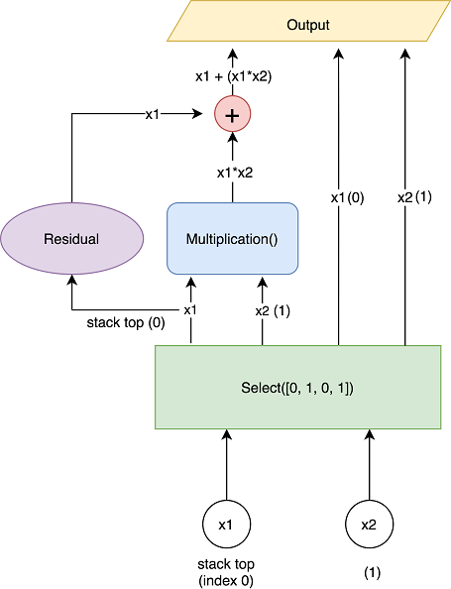
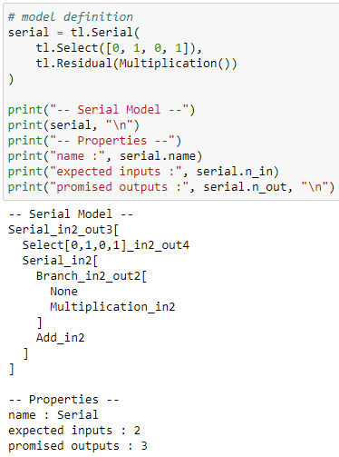
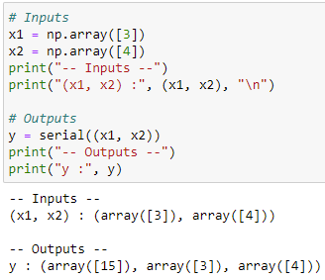
Trax – Select and Residual layers
The tl.Serial combinator is stack oriented
tl.Select requires a list of 0-based indices to select elements relative to the top of the stack
tl.Residual allows to create skip connection or shortcuts to jump over some layers
Example: Input 3, 4 and output 3 + 3*4 and the inputs

